Slide 1
Version with DO_{c} as a parameter too

Slide 2
Parameters (base model) AIC = 547.12 -LogLik = 273.56
Abbrev | Symbol | Full parameter name (fix or potentially estimate*) | Initial (or fitted) value
delM | δ_{M} | Shape corrector (fix) | 0.1066
dV | d_{V} | Dry weight density (fix) | 0.4
sJAm | Jª_{Am} | Area-specific assimilation rate | 0.333
sJM | J^{v}_{M} | Volume-specific maintenance costs | 0.0214
WB0 | W_{B0} | Initial egg weight (fix) | 0.15
Lwp | L^{M}_{p} | Total length at puberty (fix) | 100
yAV | y_{AV} | Yield of assimilates on volume, starvation (fix) | 0.8
yBA | y_{BA} | Yield of egg buffer on assimilates, reproduction (fix) | 0.95
yVA | y_{VA} | Yield of structure on assimilates, growth | 0.3646
kappa | κ | Allocation fraction to soma (fix) | 0.8
f | f | Scaled food level (fix) | 1
fB | f_{B} | Scaled food level, embryo (fix) | 1
Lwf | L_{f}? | Half-saturation total length (fix) | 0
mu_emb | h_{emb} | Mortality rate for embryos | 0.06393
mu_lar | h_{lar} | Mortality rate for larvae | 0.02940
Notes:
Can’t estimate kappa without reproduction data.

Slide 3
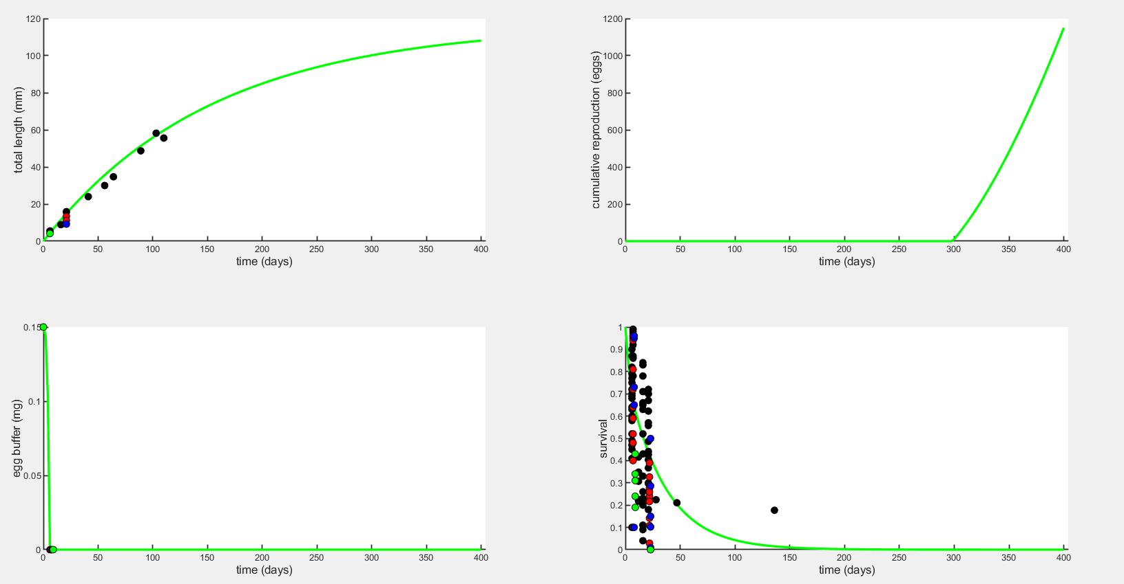
Plot to 400 days
Without hypoxia effect, the green line is control DO

Slide 4
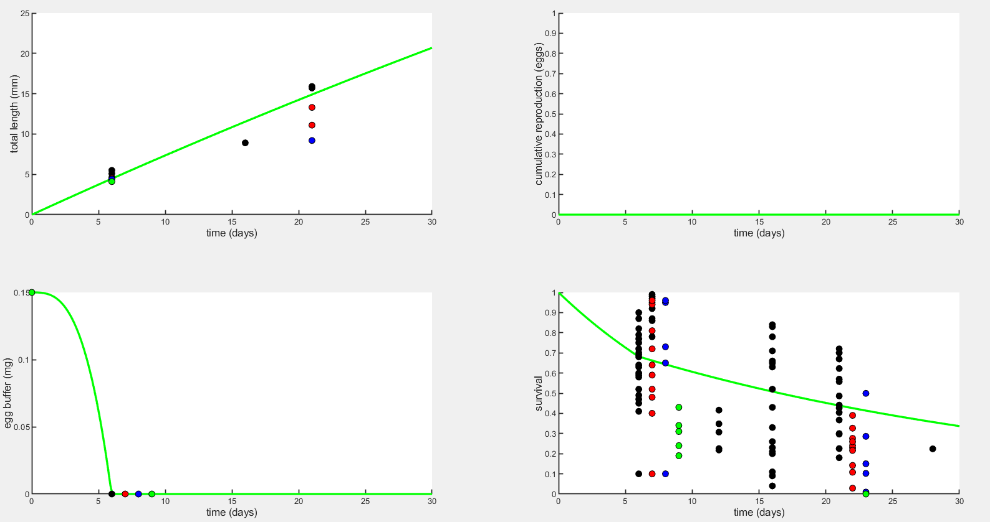
Plot to 30 days
Without hypoxia effect, the green line is control DO

Slide 5
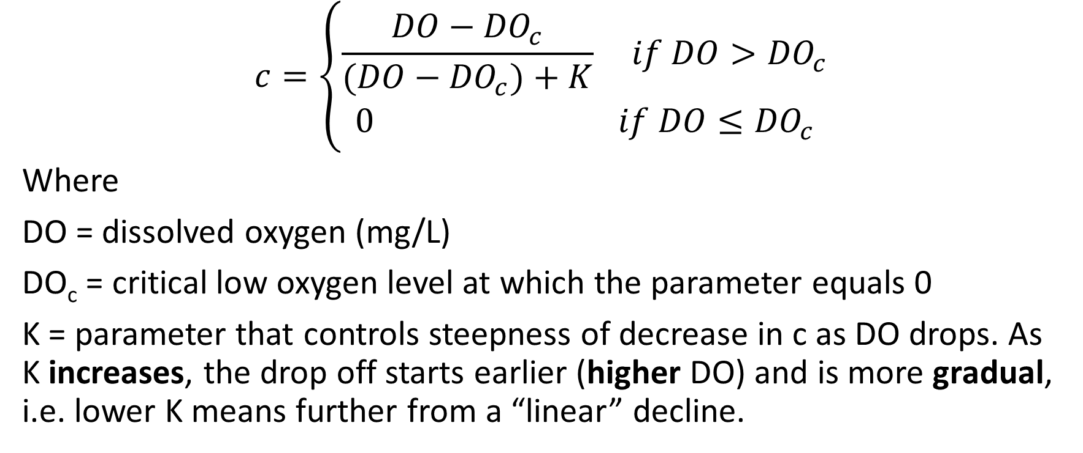
Stress function for Assimilation and Yield (Option 1)
$$c=\left\{\begin{aligned}\frac{DO−{DO}_{c}}{(DO−{DO}_{c})+K} if DO>{DO}_{c} \\ 0 if DO≤{DO}_{c}\end{aligned}\right.$$
Where
DO = dissolved oxygen (mg/L)
DO_{c} = critical low oxygen level at which the parameter equals 0
K = parameter that controls steepness of decrease in c as DO drops. As K increases, the drop off starts earlier (higher DO) and is more gradual, i.e. lower K means further from a “linear” decline.

Slide 6
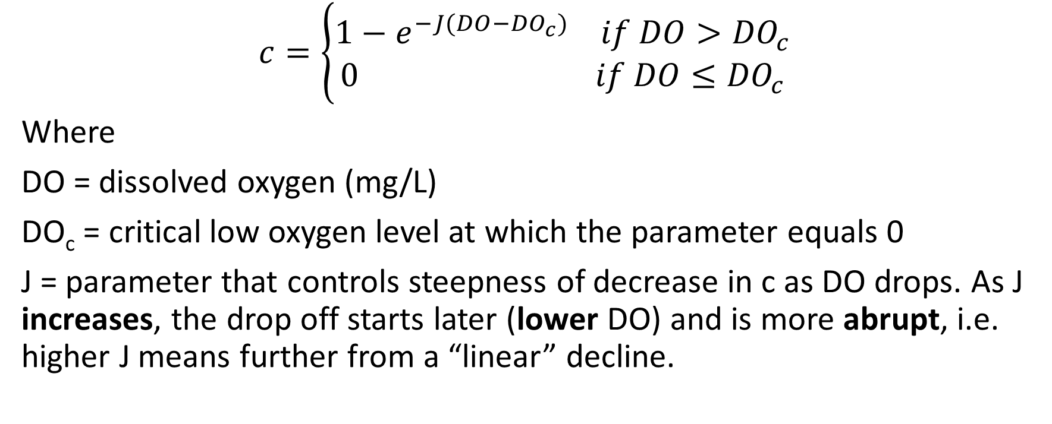
Stress function for Assimilation and Yield (Option 2)
$$c=\left\{\begin{aligned}1−e^{−J(DO−{DO}_{c})} if DO>{DO}_{c} \\ 0 if DO≤{DO}_{c}\end{aligned}\right.$$
Where
DO = dissolved oxygen (mg/L)
DO_{c} = critical low oxygen level at which the parameter equals 0
J = parameter that controls steepness of decrease in c as DO drops. As J increases, the drop off starts later (lower DO) and is more abrupt, i.e. higher J means further from a “linear” decline.

Slide 7
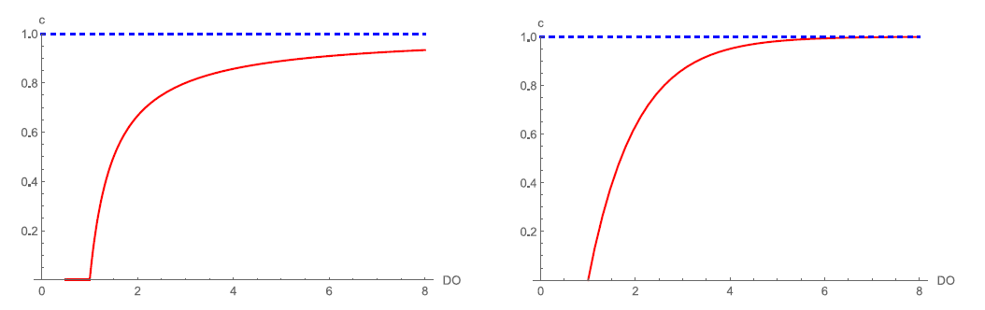
Assimilation and Yield Correction Factor
Option 1 Option 2

Slide 8
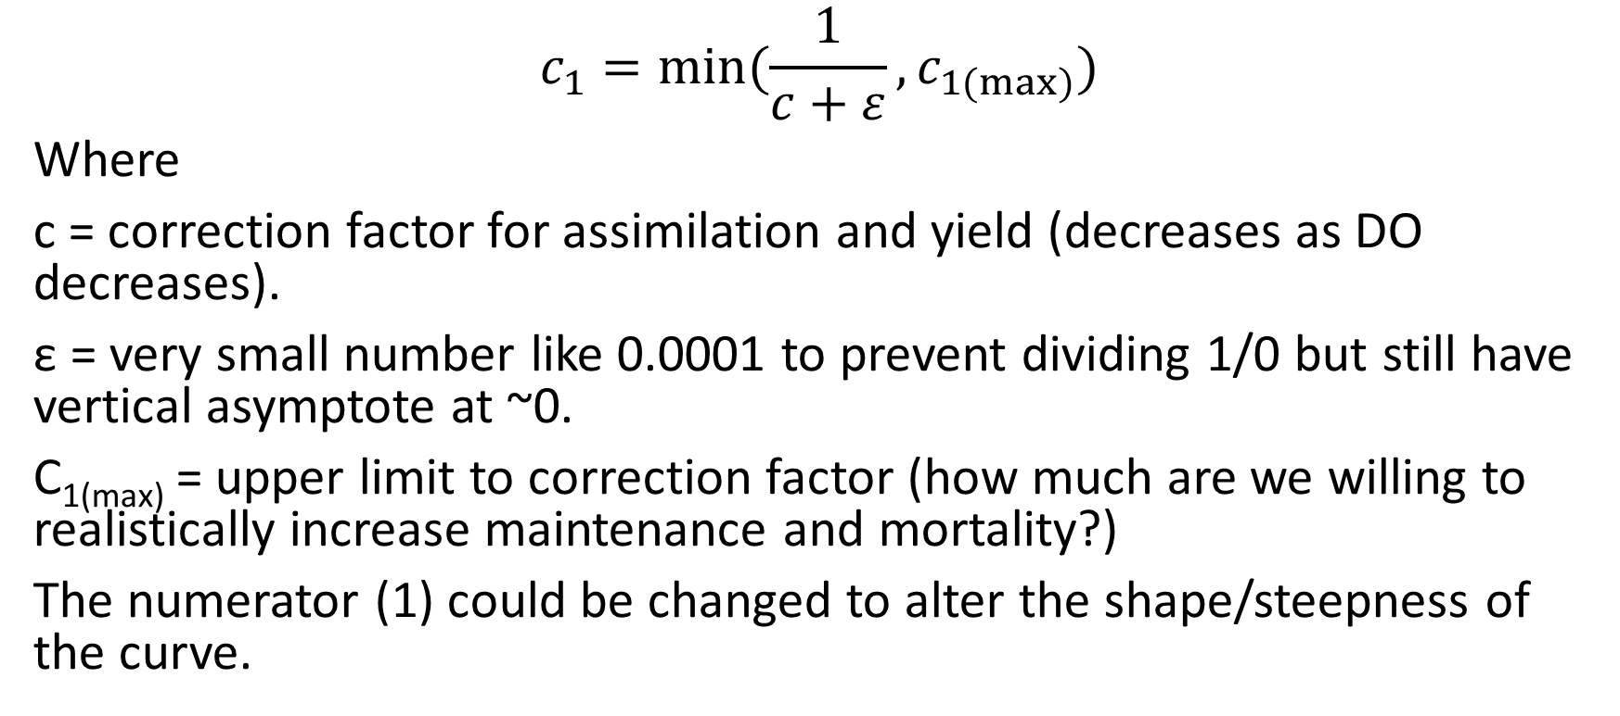
Stress function for Maintenance and Mortality
$$c_{1}=min⁡(\frac{1}{c+ε},c_{1(max⁡)})$$
Where
c = correction factor for assimilation and yield (decreases as DO decreases).
ε = very small number like 0.0001 to prevent dividing 1/0 but still have vertical asymptote at ~0.
C_{1(max)} = upper limit to correction factor (how much are we willing to realistically increase maintenance and mortality?)
The numerator (1) could be changed to alter the shape/steepness of the curve.

Slide 9
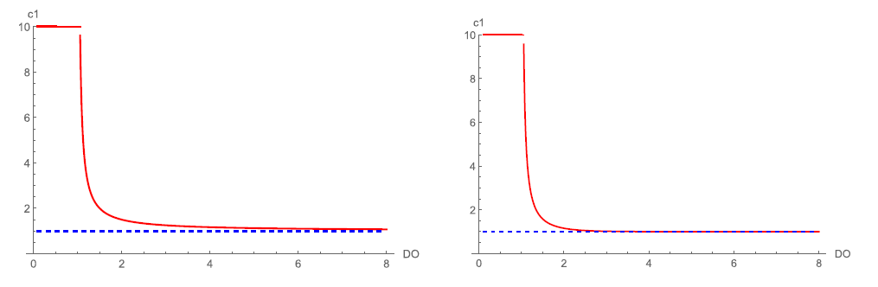
Maintenance and Mortality Correction Factor
Option 1 Option 2

Slide 10
Applying stress function to each parameter of interest
Parameter(s) affected by stress | Direction of effect | Best K | Best DO_{c} | AIC | Best J | Best DO_{c} | AIC | Notes
sJAm | ↓ | 4e-7 | 2.7 | 619.70 | 1.980 | 2.137 | 618.63 | Not strong enough at 4 and 3 mg/L.
yVA | ↓ | 7e-7 | 2.7 | 619.76 | 1.969 | 2.300 | 618.53 | Not strong enough at 4 and 3 mg/L.
sJM | ↑ | 0.5317 | 4.041 | 613.03 | 0.5154 | 3.694 | 613.03 | If limit DOc to 2.7 it chooses 2.7 and K=0.7367 or J=0.41, and AIC is slightly higher (by <1).
mu_emb | ↑ | 0.2685 | 2.604 | 602.72 | 1.345 | 2.459 | 603.89
mu_lar | ↑ | 0.9045 | 2.588 | 594.46 | 0.4857 | 2.428 | 594.32 | Actually gets the survival low enough.
sJAm & sJM | ↓ & ↑ | 1e-16 | 1.103 | 624.81 | 1.966 | 2.126 | 618.61 | Not strong enough at 4 and 3 mg/L.
yVA & sJM | ↓ & ↑ | 3e-7 | 2.700 | 619.76 | 1.928 | 2.286 | 618.50 | Not strong enough at 4 and 3 mg/L.
Does estimating DO_{c} improve fit?
What if only do one at a time – estimate DOc, then fix it and estimate K/J?
-As long as it is lower than 2.7 mg/L, DO_{c} only affects the best value of K/J so it is probably best to just fix it at a reasonable value such as 2.04 (embryo Pcrit). Estimating both has been complicated, there are too many options that are similar.
-It might be more important to fix it at a value we know makes sense.
May need to set an upper bound where c=1 so that control has no hypoxia effect.
-Would that help it fit better to the other treatment levels?

Slide 11
Applying stress function to each parameter of interest
Parameter(s) affected by stress | Direction of effect | Best K | Best DO_{c} | AIC | Best J | Best DO_{c} | AIC | Notes
sJAm & mu_emb | ↑ & ↓ | 2e-5 | 2.700 | 610.64 | 1.864 | 2.102 | 609.02
yVA & mu_emb | ↑ & ↓ | 5e-5 | 2.700 | 607.40 | 1.948 | 2.296 | 605.53
mu_emb & mu_lar | ↑ & ↑ | 0.2845 | 2.544 | 598.42 | 0.7157 | 1.967 | 599.28
sJM & mu_emb | ↑ & ↑ | 0.6019 | 2.457 | 597.21 | 0.3605 | 1.445 | 599.50
sJAm & mu_lar | ↓ & ↑ | 4e-8 | 2.700 | 616.07 | 1.813 | 2.086 | 613.85
yVA & mu_lar | ↓ & ↑ | 1e-7 | 2.700 | 614.32 | 1.675 | 2.230 | 611.35
sJM & mu_lar | ↑ & ↑ | 0.7484 | 2.667 | 586.95 | 0.3970 | 2.405 | 585.85
sJAm & mu_lar & mu_emb | ↓&↑&↑ | 8e-7 | 2.700 | 608.41 | 1.779 | 2.074 | 605.80 | It took about 14 minutes to run with loglik profiles.
sJM & mu_lar & mu_emb | ↑&↑&↑ | 0.5486 | 2.361 | 593.46 | 0.3510 | 0.9460 | 595.14
sJAm & sJM & mu_emb & mu_lar | ↓&↑&↑&↑ | 2e-15 | 2.025 | 624.81 | 1.755 | 2.057 | 605.93
yVA & mu_emb & mu_lar |  |  |  |  | 1.326 |  | 584.48

Slide 12
Plot legend
Black = 8 mg/L (control)
Red = 4 mg/L
Blue = 3 mg/L
Green = 2.5 mg/L

Slide 13
Mean data values for each DO treatment
This could be useful when viewing the plots and how well the predicted values fit (because for survival and length there are multiple data points on the plot).
 | 7.7 mg l⁻¹ | 4.2 mg l⁻¹ | 3.1 mg l⁻¹ | 2.7 mg l⁻¹
Survival to hatching | 74.3% (range 41-100%) | 70.6% (range 40-100%) | 85.8% (range 65-100%) | 30.2% (range 19-43%)
Hatch time (egg buffer=0) | 6 days | 7 days | 8 days | 9 days
Length at hatching | 5.3 mm | 4.55 mm | 4.4 mm | 4.1 mm
Larval length at 15 dph* | 15.8 mm | 12.2 mm | 9.2 mm | NA
Larval survival to 15 dph* | 44.0% (range 4-84%) | 22.2% (range 3-33%) | 20.9% (range 1-50%) | 0% (range 0-0%)
*15 days post hatching = 21-24 days post fertilization, because low oxygen delays hatching

Slide 14
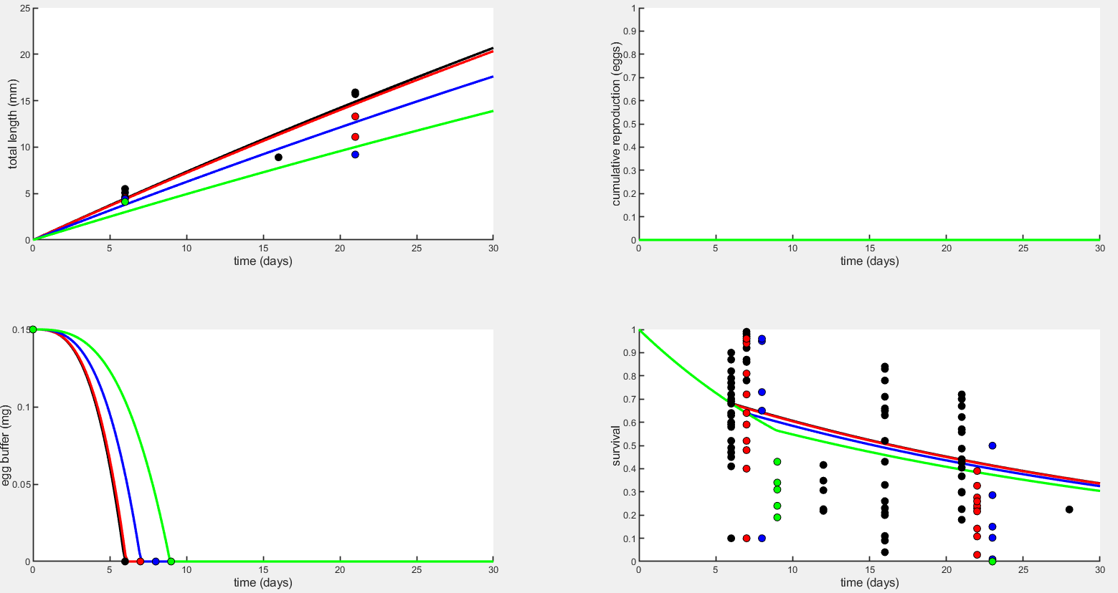
Early life plots – Assimilation (sJAm) with Option 2 (J=1.969, DOc=2.3)

Slide 15
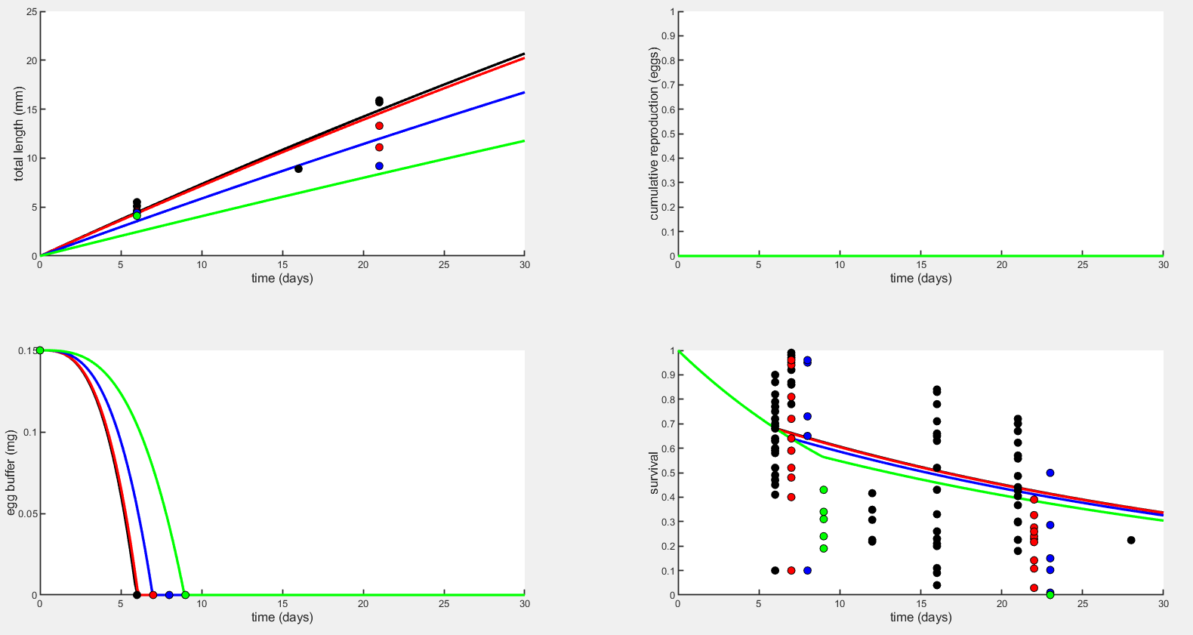
Early life plots – Yield coef for growth (yVA) with Option 2 (J=1.969, DOc=2.3)

Slide 16
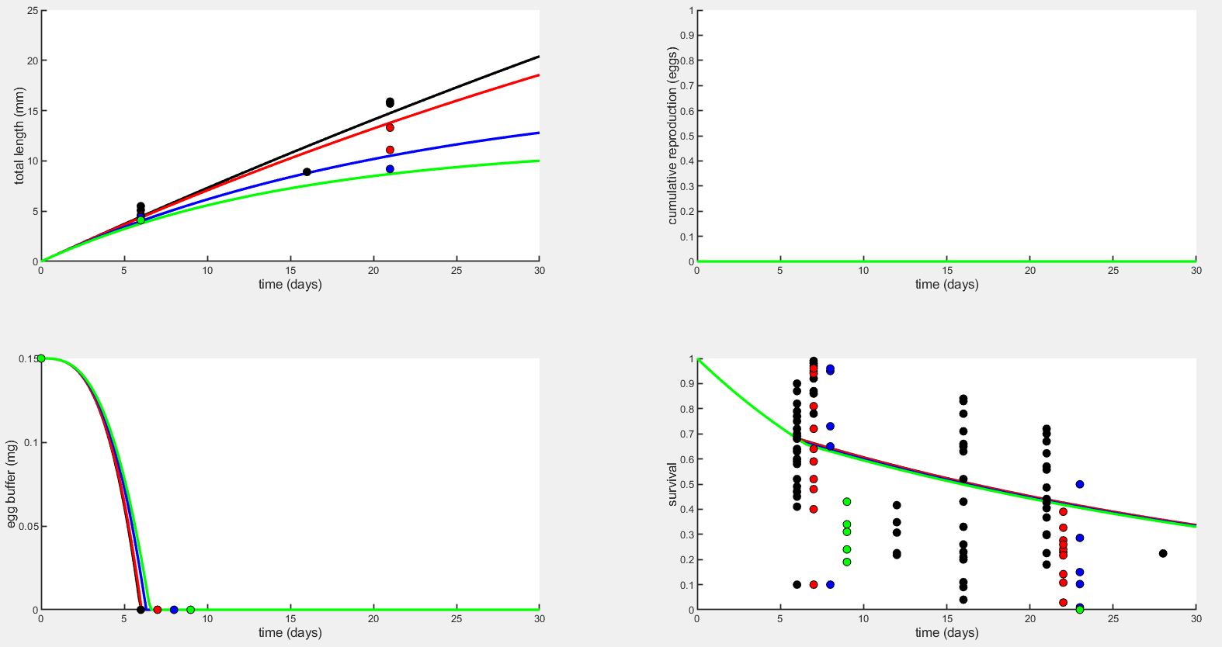
Early life plots – Maintenance (sJM) with Option 2 (J=0.41, DOc=2.7)

Slide 17
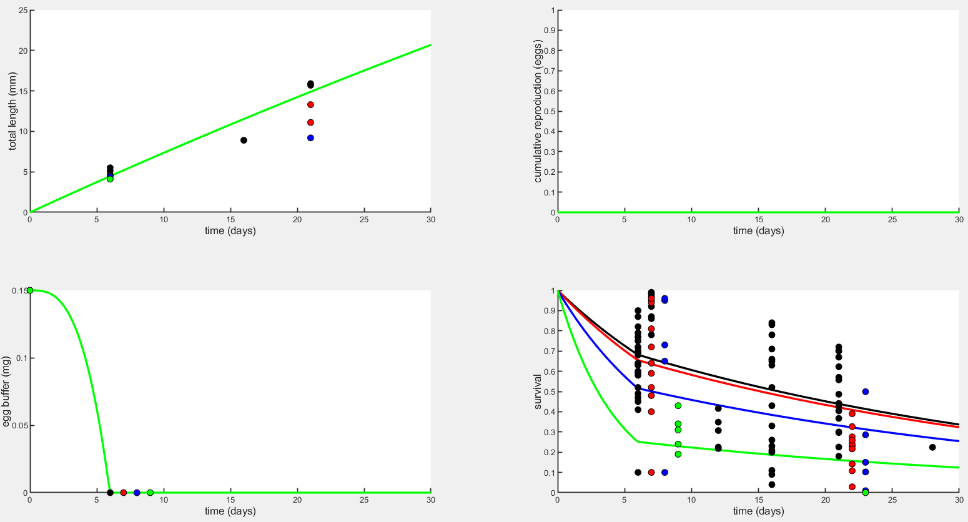
Early life plots – Embryo mortality (mu_emb) with Option 2 (J=1.345, DOc=2.459)

Slide 18
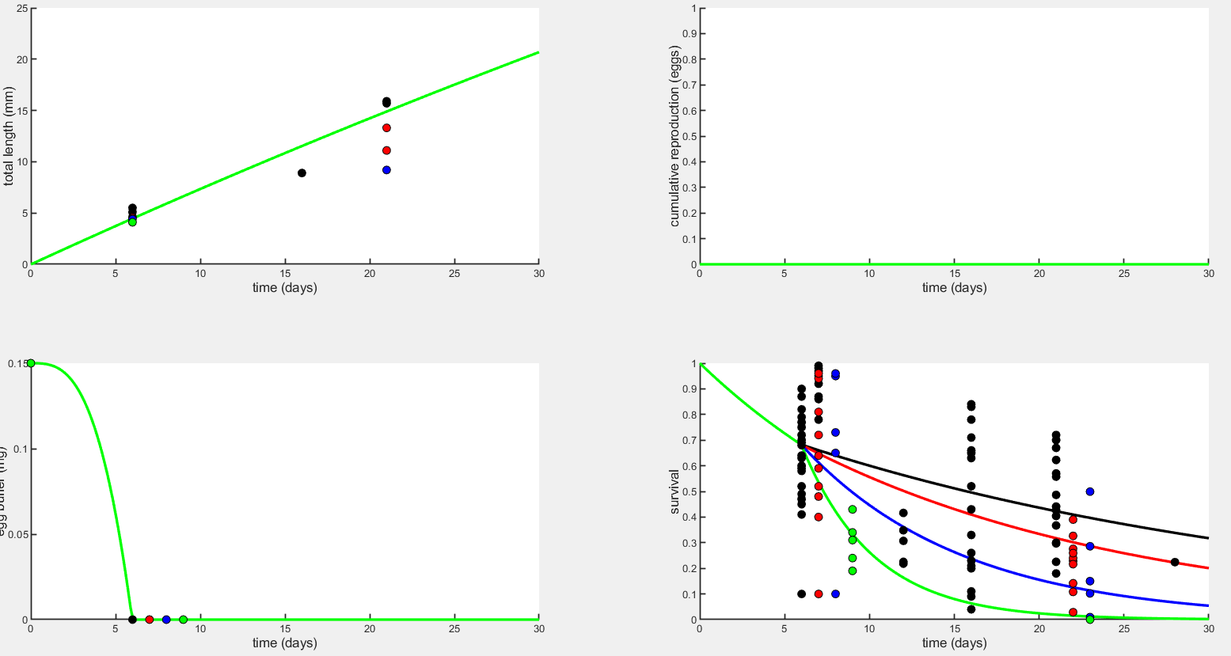
Early life plots – Larval mortality (mu_lar) with Option 2 (J=0.4857, DOc=2.428)

Slide 19
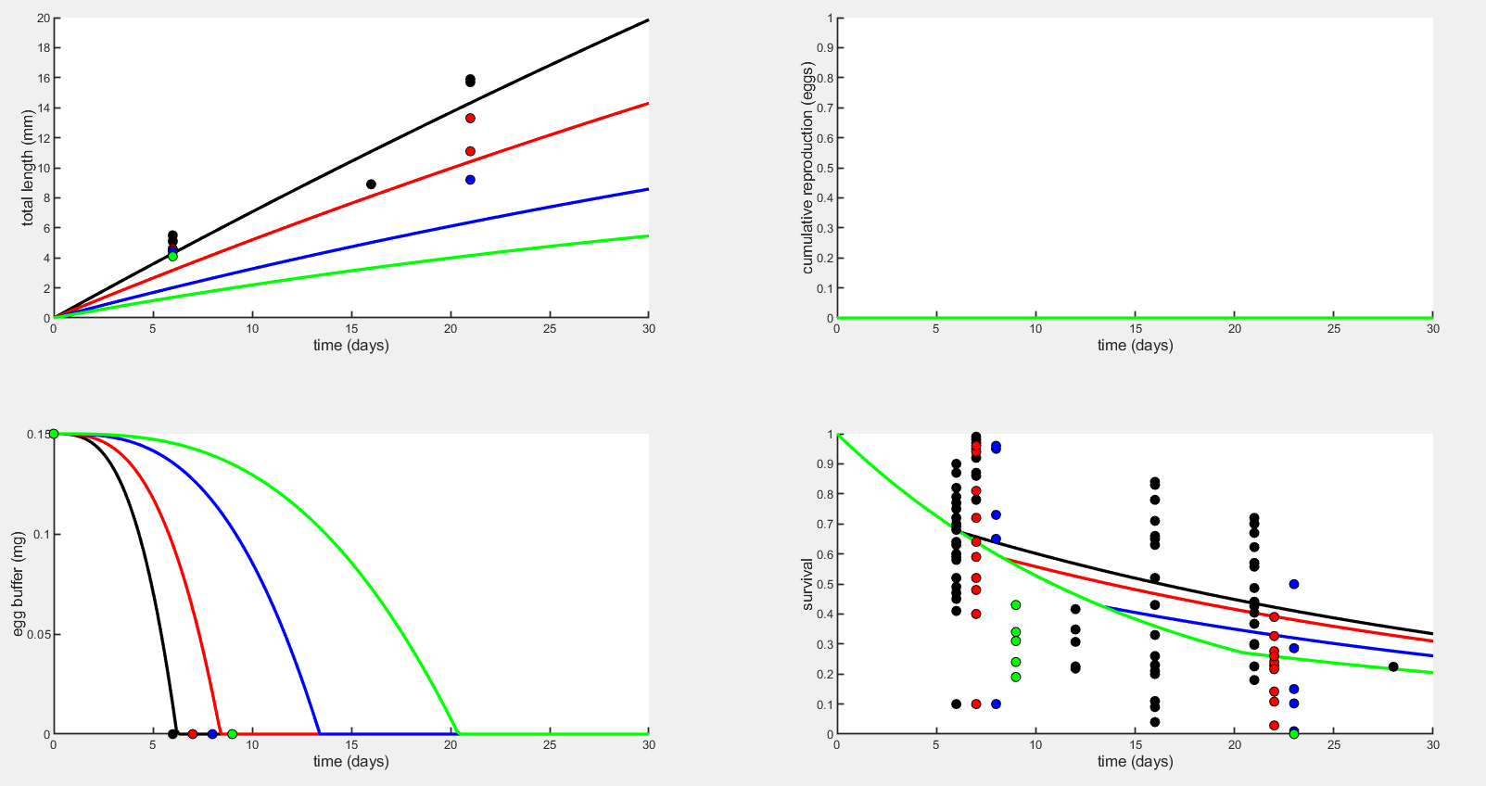
Early life plots – sJAm & sJM with Option 2 (J=0.58)

Slide 20

Early life plots – yVA & sJM with Option 2 (J=1.928, DOc=2.286)

Slide 21
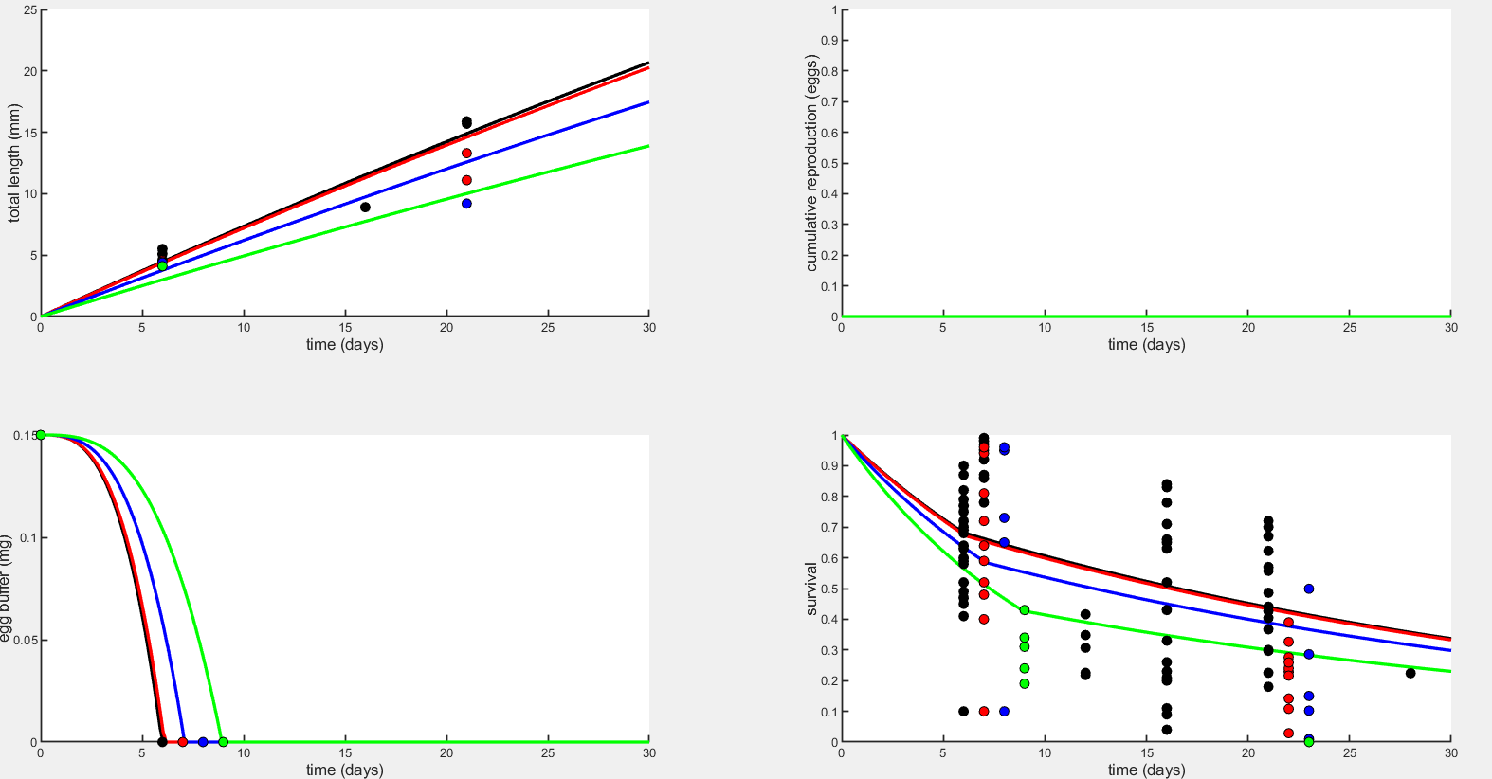
Early life plots – sJAm & mu_emb with Option 2 (J=1.864, DOc=2.102)

Slide 22
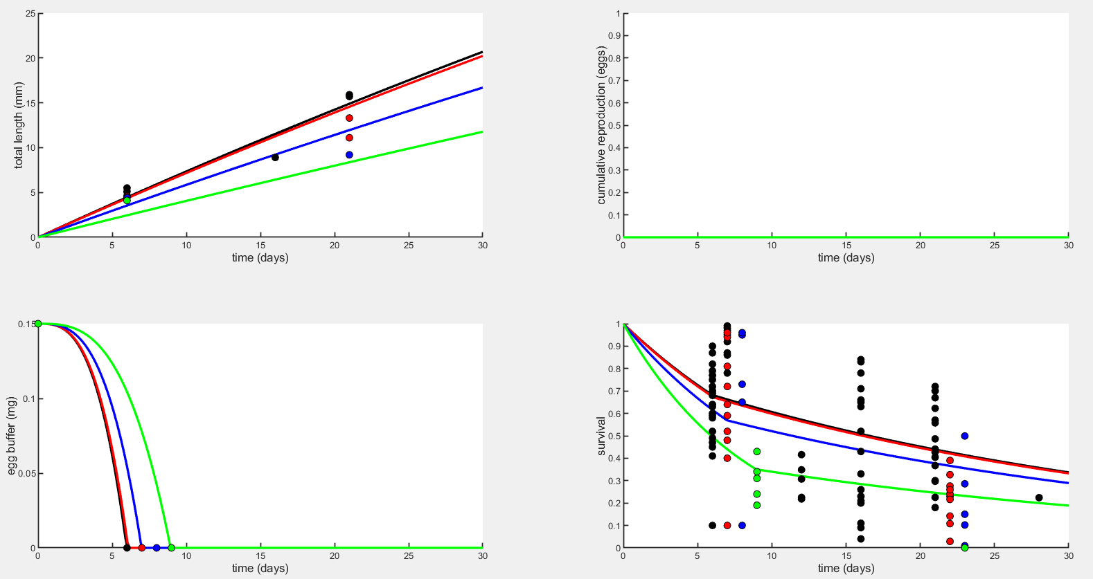
Early life plots – yVA & mu_emb with Option 2 (J=1.948, DOc=2.296)

Slide 23
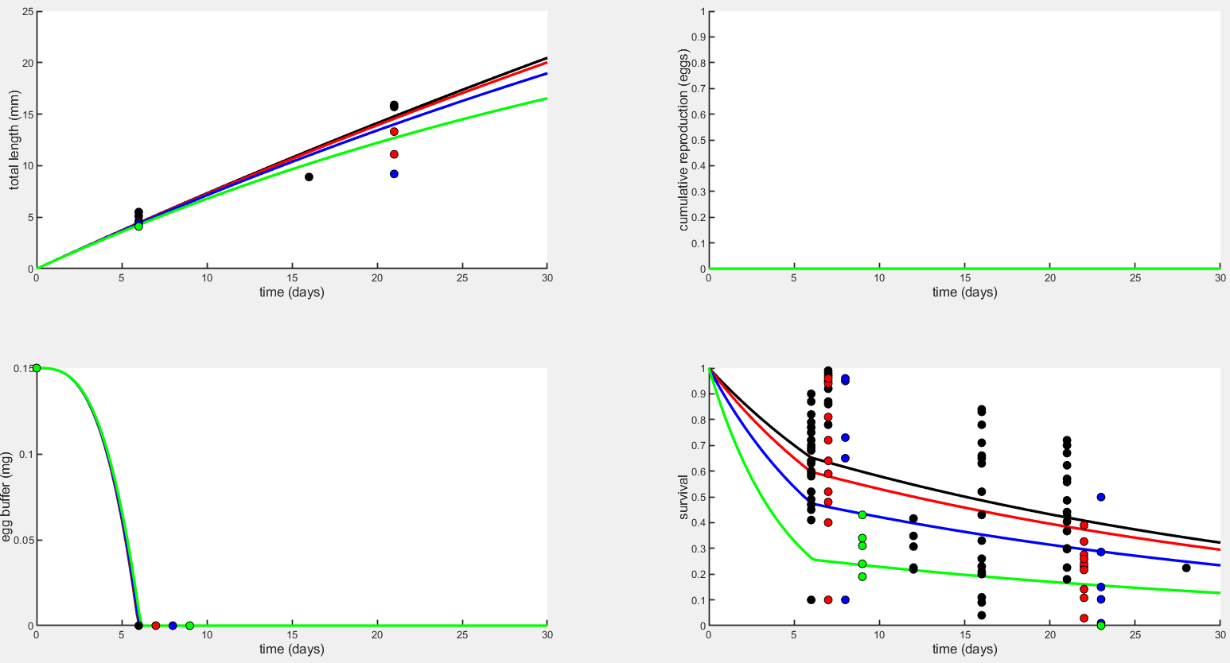
Early life plots – sJM & mu_emb with Option 1 (K=0.6019, DOc=2.457)

Slide 24
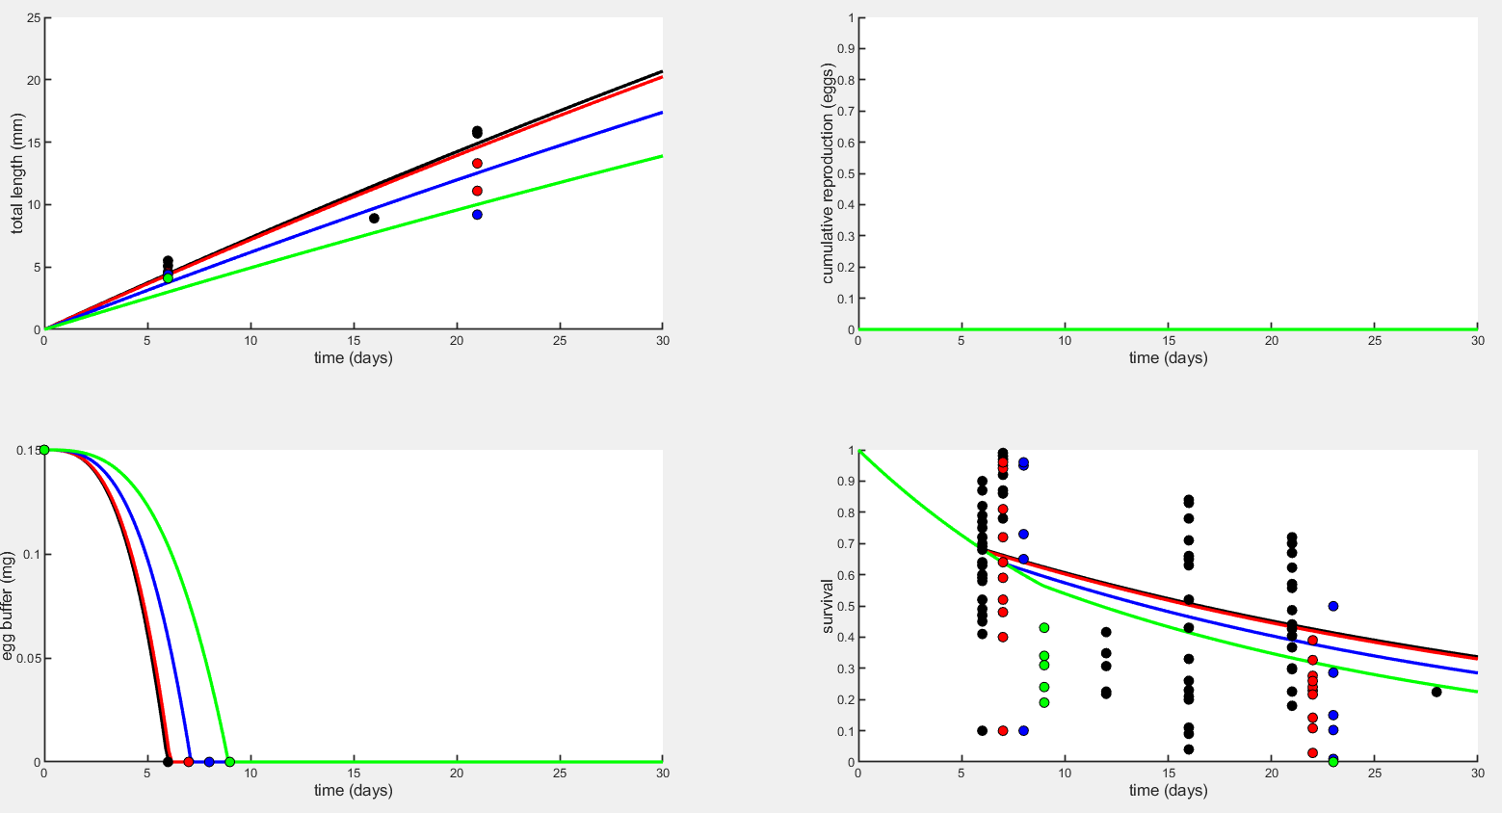
Early life plots – sJAm & mu_lar with Option 2 (J=1.813, DOc=2.086)

Slide 25
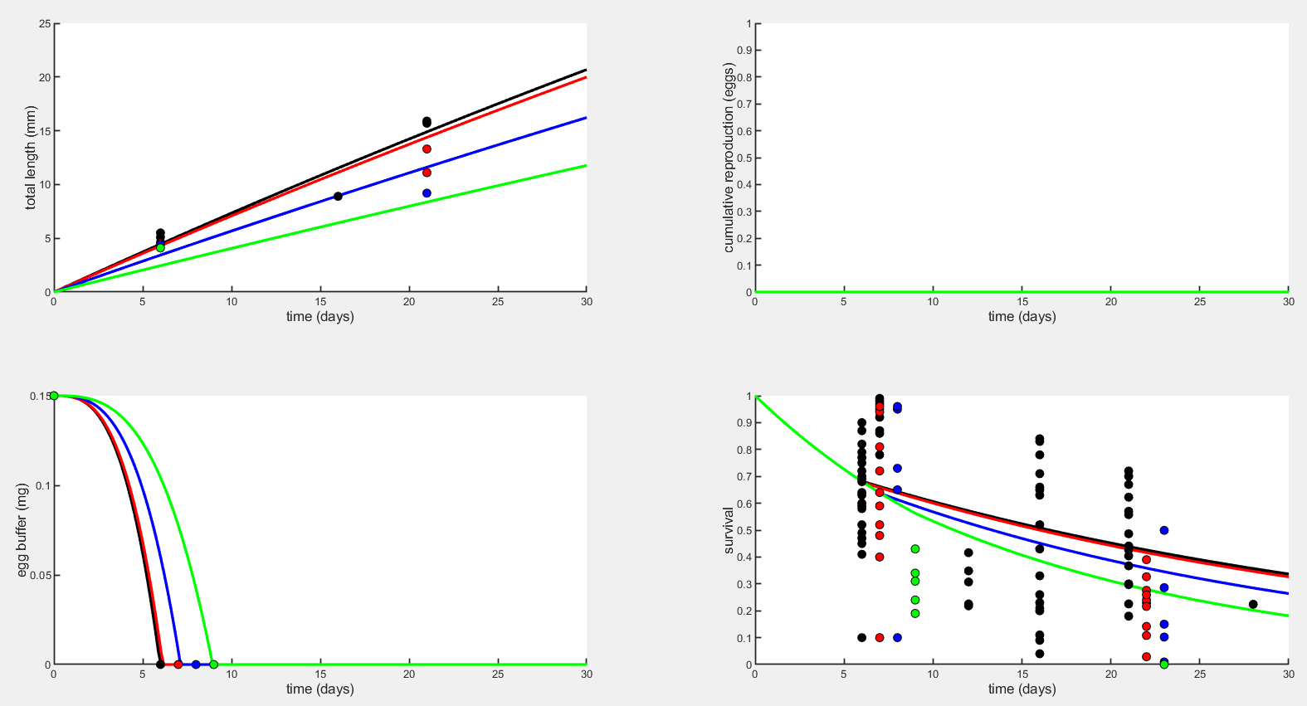
Early life plots – yVA & mu_lar with Option 2 (J=1.675, DOc=2.23)

Slide 26
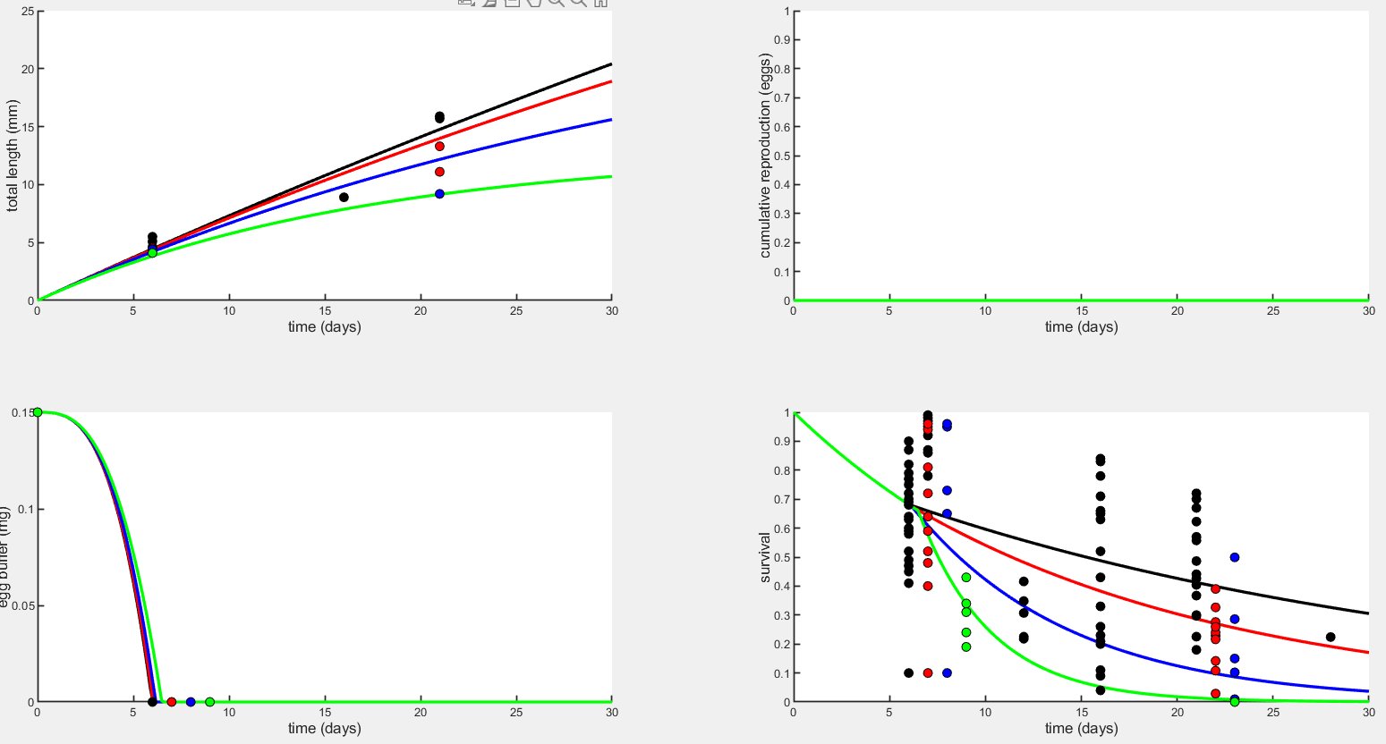
Early life plots – sJM & mu_lar with Option 2 (J=0.3970, DOc=2.405)

Slide 27
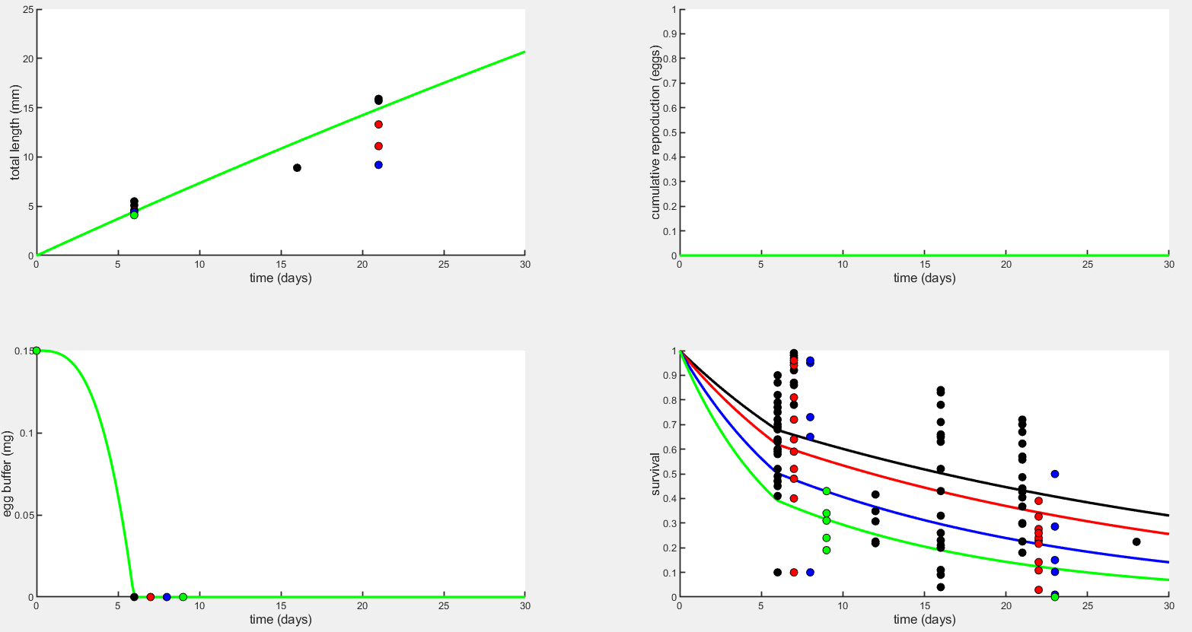
Early life plots – mu_emb & mu_lar with Option 2 (J=0.7157, DOc=1.967)

Slide 28
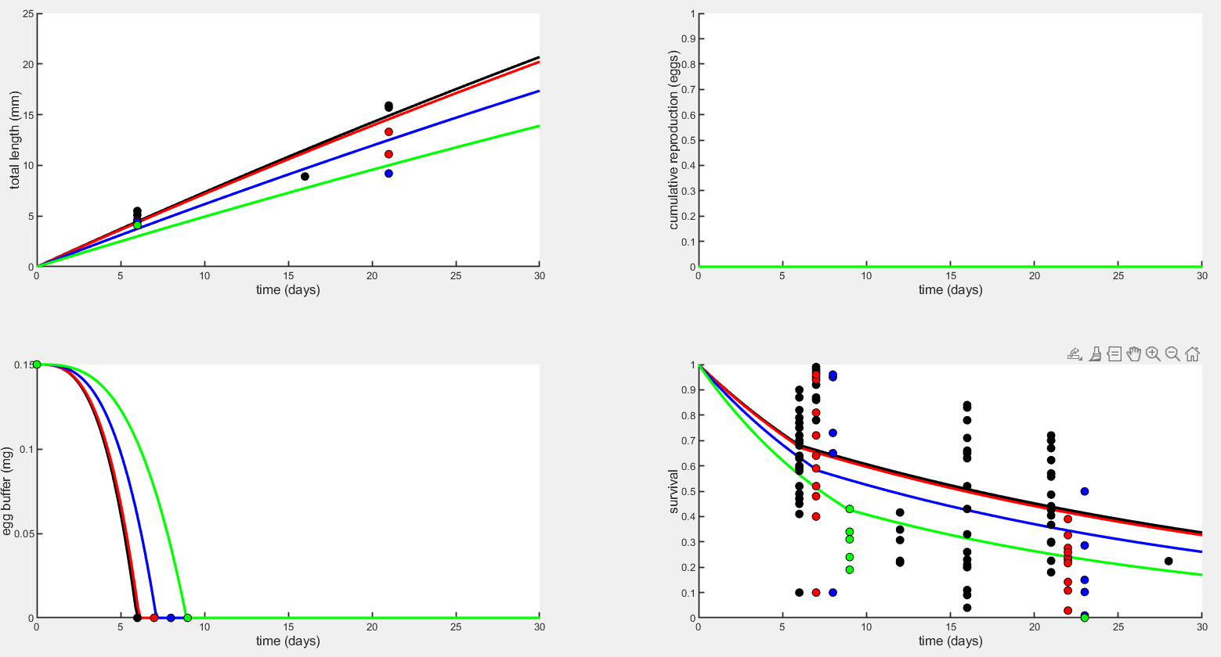
Early life plots – sJAm, mu_emb, & mu_lar with Option 2 (J=1.779, DOc=2.074)

Slide 29
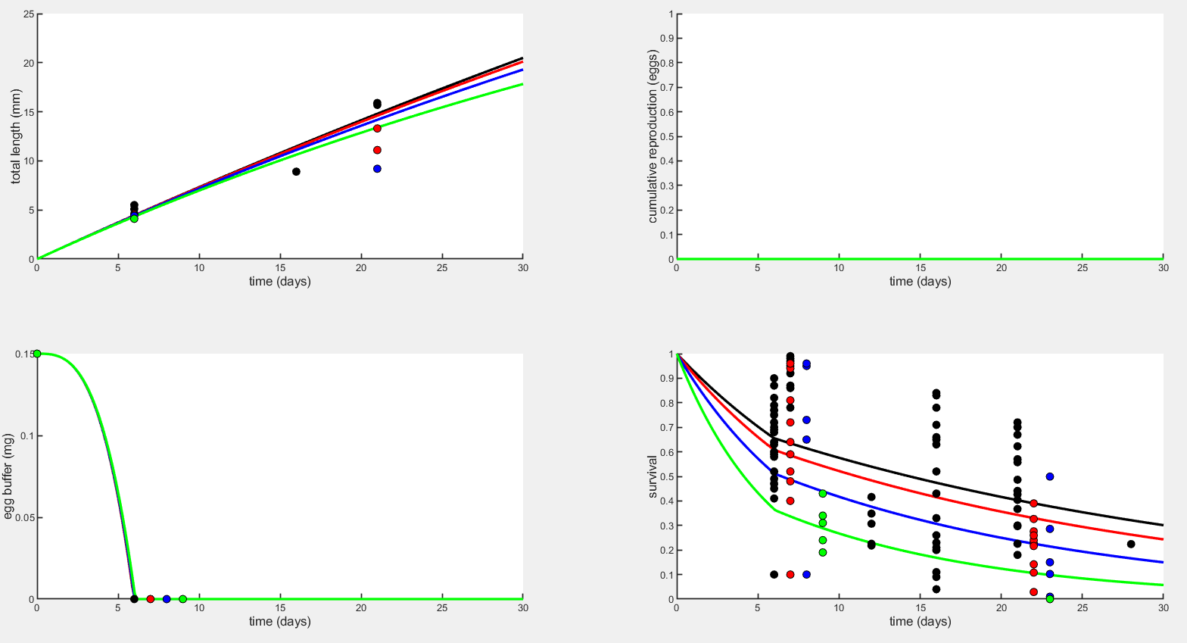
Early life plots – sJM, mu_emb, & mu_lar with Option 1 (K=0.5486, DOc=2.361)

Slide 30
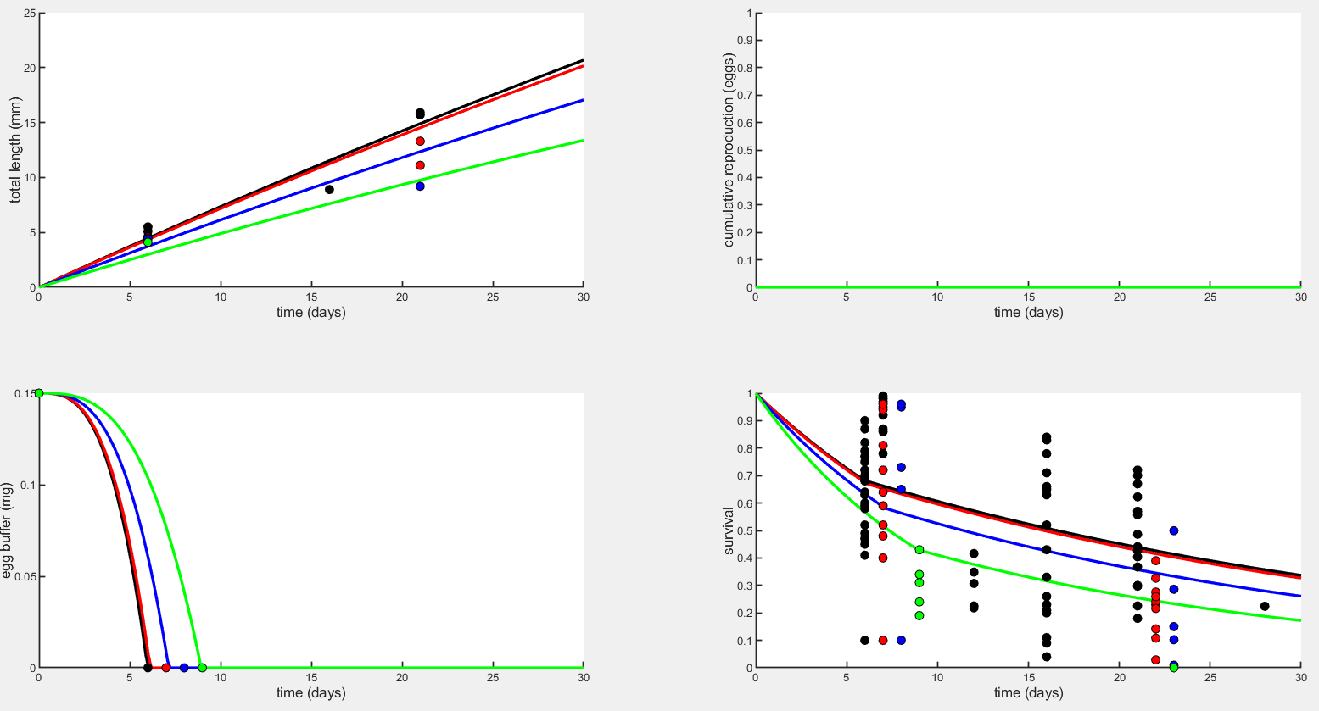
Early life plots – sJAm, sJM, mu_emb, & mu_lar with Option 2 (J=1.755, DOc=2.057)

